Slide 1

Predicting presence of Heart Disease using Machine Learning
Presented By –
Dipanjan Maity (11500117113)
Jiban Barman (11500117105)
Dwaipayan Dinda (11500117111)
Akash Roy (11500117138)

Slide 2

Abstract
In this project we have demonstrated that, how we can use various Machine Learning algorithm to predict heart disease of a patient in an early stage based on some common medical data.

Slide 3
Introduction and a little statistics
Machine Learning is used across many spheres around the world. The healthcare industry is no exception. Machine Learning can play an essential role in predicting presence/absence of Locomotor disorders, Heart diseases and more. Such information, if predicted well in advance, can provide important insights to doctors who can then adapt their diagnosis and treatment per patient basis.
Here some general overviews about Heart Disease or Cardiovascular Disease (CVD)
17.9 million people die each year from CVDs, an estimated 31% of all deaths worldwide.
>75% of CVD deaths occur in low- and middle-income countries.
85% of all CVD deaths are due to heart attacks and strokes.

Slide 4





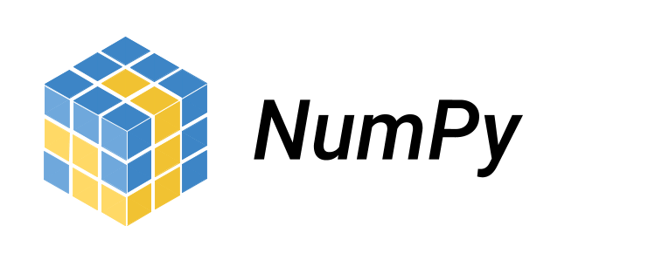

Tools & Technologies Used

Slide 5
A brief introduction of Machine Learning
Machine learning is a field of study that gives computers the ability to learn without being explicitly programmed.
It is a subset of Artificial Intelligence(AI) which uses a set of numerical data and perform some iterative statistical analysis to conclude a hypothesis and predicts information about the new set of data with the help of that hypothesis.
As this process learns or concludes the hypothesis from the experience so the predicted outcome is not accurate. So there exists some accuracy of the prediction which increases according to the learning data set’s volume as well as correctness.

Slide 6
Types of Machine Learning
We can broadly classify machine learning into to types –
Supervised Learning – It is the type of machine learning in which models are trained using well "labelled" training data, and on basis of that data, machines predict the output.
Unsupervised Learning – It is the type of machine learning in which models are trained using unlabeled dataset and are allowed to act on that data without any supervision.
Along with this two major class their also exists a type of machine learning which is known as
Reinforcement Learning.
It features an algorithm that improves upon itself and learns from new situations using a trial-and-error method. Favorable outputs are encouraged, or ‘reinforced’, and non-favorable outputs are discouraged or ‘punished’.
We will use Supervised Machine learning and its algorithms as our training dataset is well labelled.

Slide 7
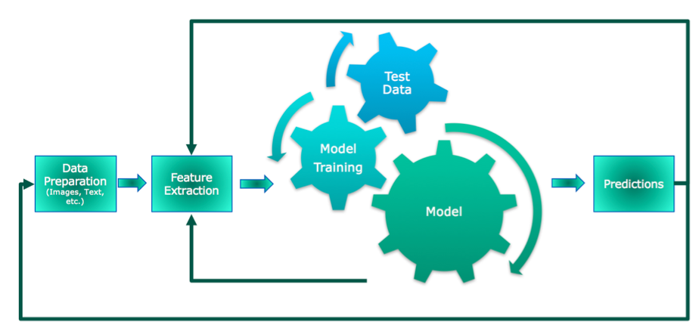
A Standard Machine Learning Process

Slide 8
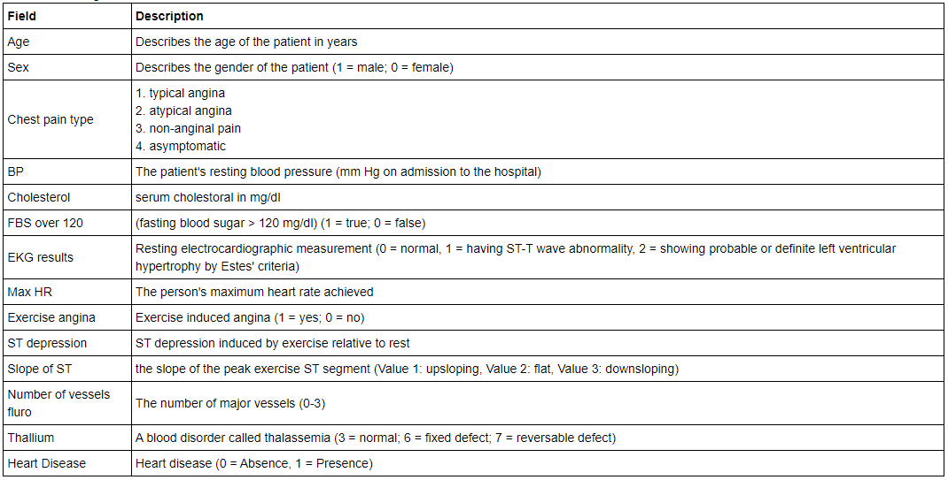
The Dataset

Slide 9
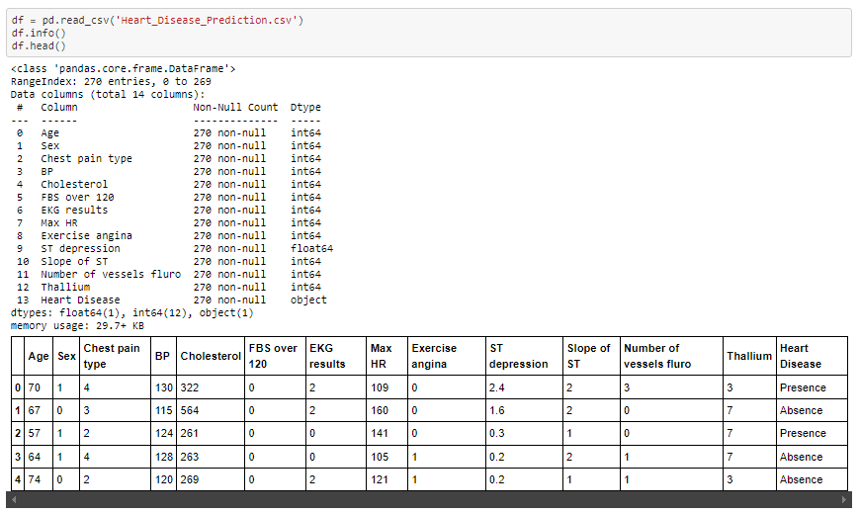
Dataset Insights

Slide 10
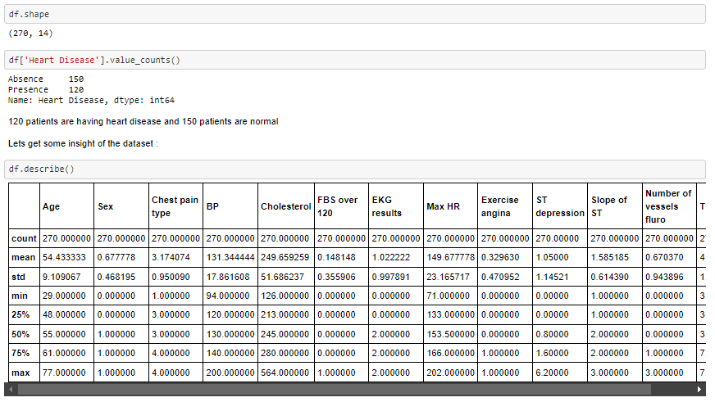
Dataset Insight contd.

Slide 11
Visualization of the data and relationship among the attributes and target
The problem we are going to solve is a typical classification problem. Based of some demographic data about a patient’s health condition such as age, gender, maximum heart rate, exercise angina, fasting blood sugar etc. we must prepare a model which can predict or classify that either a patient poses heart issue or not.
In the dataset there are 13 independent attributes or features which somehow concludes the target, that is if a patient have any heart disease or not.
To get a rough idea about the relation between the target and features we have used data visualization techniques using matplotlib and seaborn data visualization library available for python.
We have two types of features in our dataset –
Categorial features or discrete valued features ( 9 attributes including target )
Numeric features or continuous valued features ( 5 attributes )

Slide 12
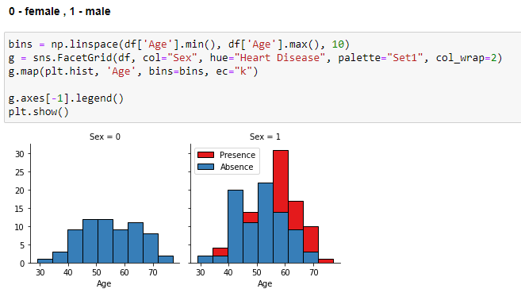
Relationship between Age and target for both gender

Slide 13
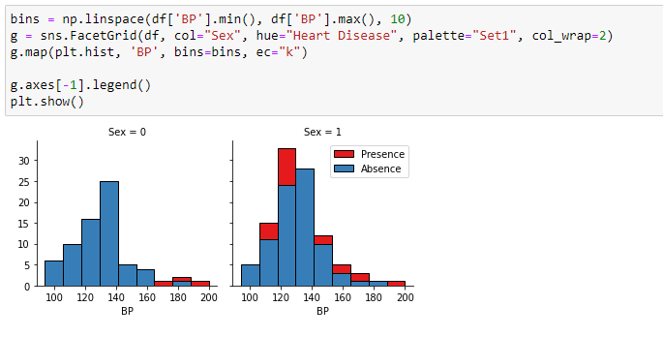
Relationship between Blood pressure and target for both gender

Slide 14
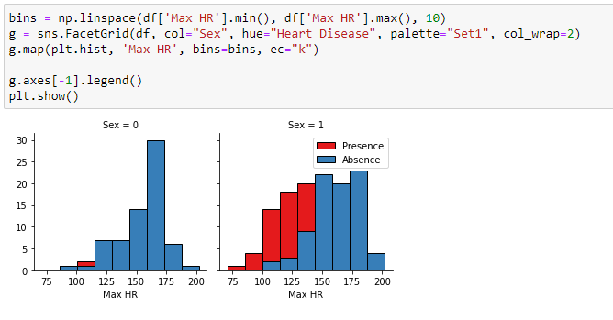
MAX HR wise positive case for both gender

Slide 15
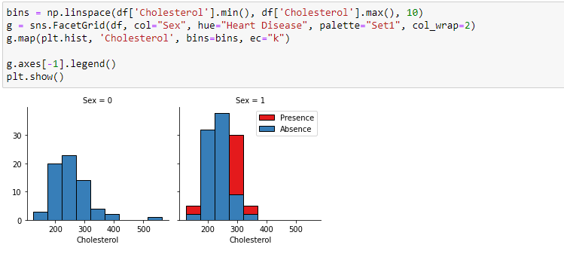
Cholesterol wise positive case for both gender

Slide 16
Pre-processing: Feature selection/extraction
Correlation Matrix with Heatmap —
Correlation indicates how the features are related to each other or to the target variable. The correlation may be positive (increase in one value of the feature increases the value of the target variable) or negative (increase in one value of the feature decreases the value of the target variable) Heatmap makes it easy to classify the features are most relevant to the target variable, and we will plot the associated features of the heatmap using the seaborn library.

Slide 17
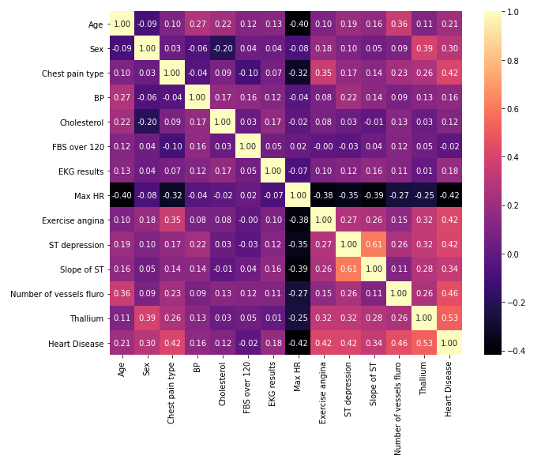
Heatmap
From this heatmap we can observe that the 'Thallium' and 'Number of vessels Fluro' is highly related to the target variable. Compared to relation between other two variables we can say that 'Thallium' and 'Number of vessels Fluro' contributes the most in prediction of presences of a heart disease.

Slide 18
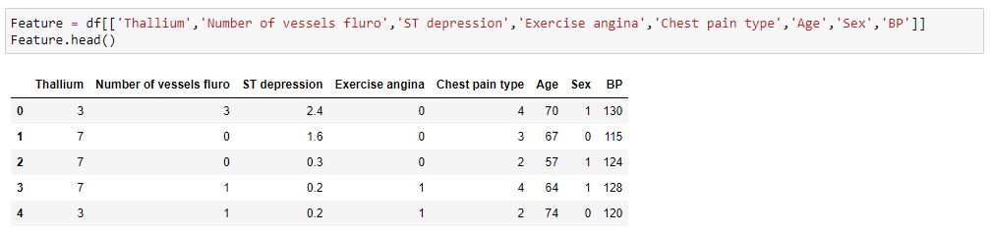
Feature Selection
After visualizing the relationship between various feature and target and observing the heatmap we
Have selected 8 features or attributes to train our model.

Slide 19
Splitting of train and test data
The train-test split is a technique for evaluating the performance of a machine learning algorithm.
It can be used for classification or regression problems and can be used for any supervised learning algorithm.
The procedure involves taking a dataset and dividing it into two subsets. The first subset is used to fit the model and is referred to as the training dataset. The second subset is not used to train the model; instead, the input element of the dataset is provided to the model, then predictions are made and compared to the expected values. This second dataset is referred to as the test dataset.
Train Dataset: Used to fit the machine learning model.
Test Dataset: Used to evaluate the fit machine learning model.
The objective is to estimate the performance of the machine learning model on new data: data not used to train the model.

Slide 20
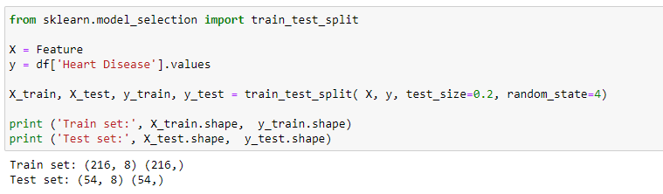
Training & Testing Data

Slide 21
Feature Normalization
Normalization is a technique often applied as part of data preparation for machine learning. The goal of normalization is to change the values of numeric columns in the dataset to use a common scale, without distorting differences in the ranges of values or losing information. Normalization is also required for some algorithms to model the data correctly.
For example, let’s assume an input dataset contains one column with values ranging from 0 to 1, and another column with values ranging from 10,000 to 100,000. The great difference in the scale of the numbers could cause problems when you attempt to combine the values as features during modeling.
Normalization avoids these problems by creating new values that maintain the general distribution and ratios in the source data, while keeping values within a scale applied across all numeric columns used in the model.
Normalizing the data generally speeds up learning and leads to faster convergence.

Slide 22
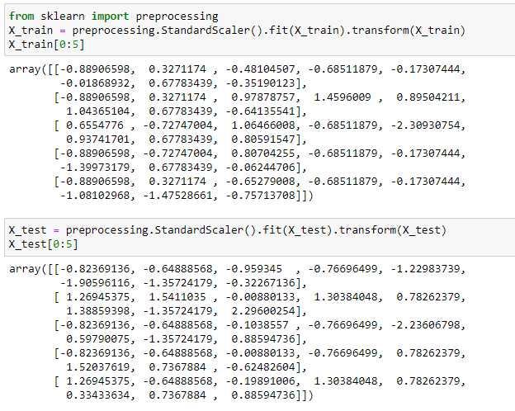
Feature Normalization contd.

Slide 23
Classification
Algorithms -
K Nearest Neighbor(KNN)
Decision Tree
Support Vector Machine
Logistic Regression
We have done a comparative study among these four supervised machine learning algorithm to predict the presence of heart disease.

Slide 24
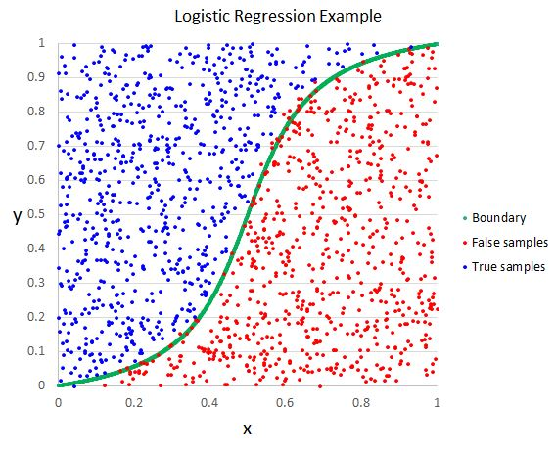
Logistic Regression or Binary Classification
Logistic regression is a supervised learning classification algorithm used to predict the probability of a target variable.
In simple words, the dependent variable is binary in nature having data coded as either 1 (stands for success/yes) or 0 (stands for failure/no).
Mathematically, a logistic regression model predicts P(Y=1) as a function of X. It is one of the simplest ML algorithms that can be used for various classification problems such as spam detection, Diabetes prediction, cancer detection etc.

Slide 25
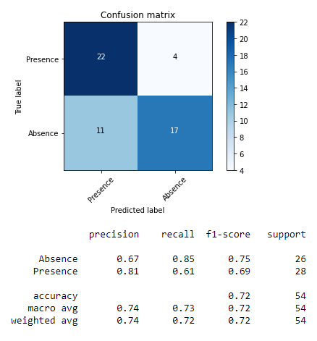
Performance analysis of Logistic Regression Model
Logistic Regression’s training Accuracy: 0.8796
Logistic Regression’s testing Accuracy: 0.7222
Average F1-score: 0.7189
Jaccard score: 0.5312
Log Loss: 0.5385

Slide 26

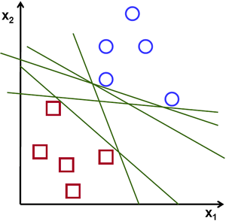
Support Vector Machine Classifier
The objective of the support vector machine algorithm is to find a hyperplane in an N-dimensional space(N — the number of features) that distinctly classifies the data points.
To separate the two classes of data points, there are many possible hyperplanes that could be chosen. Our objective is to find a plane that has the maximum margin, i.e. the maximum distance between data points of both classes.
Maximizing the margin distance provides some reinforcement so that future data points can be classified with more confidence.

Slide 27
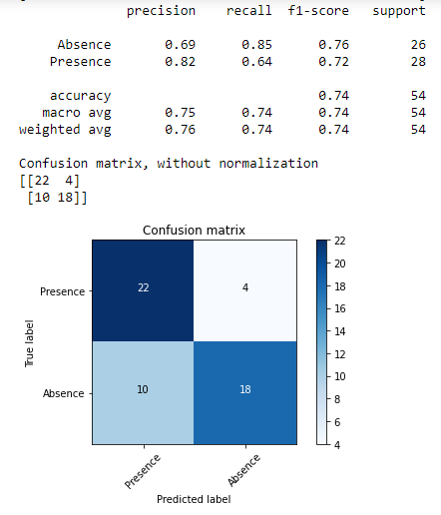
Performance analysis of SVM Model
SVC’s training Accuracy: 0.9213
SVC’s testing Accuracy: 0.7407
Average F1-score: 0.7386
Jaccard score: 0.5625

Slide 28
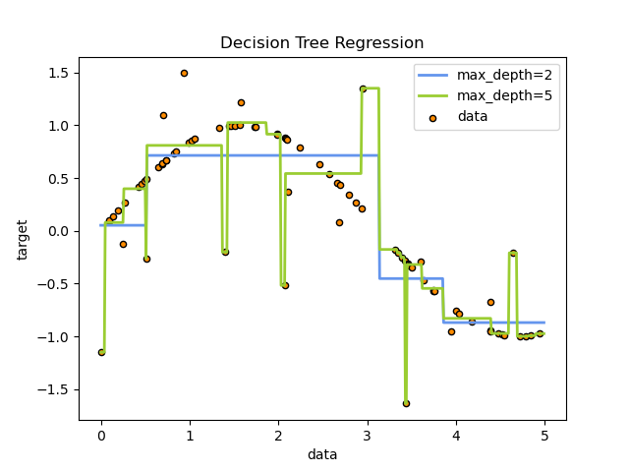
Decision Tree Classifier
Decision Trees (DTs) are a non-parametric supervised learning method used for classification and regression.
The goal is to create a model that predicts the value of a target variable by learning simple decision rules inferred from the data features.
A tree can be seen as a piecewise constant approximation.
For instance, in the example below, decision trees learn from data to approximate a sine curve with a set of if-then-else decision rules. The deeper the tree, the more complex the decision rules and the fitter the model.

Slide 29
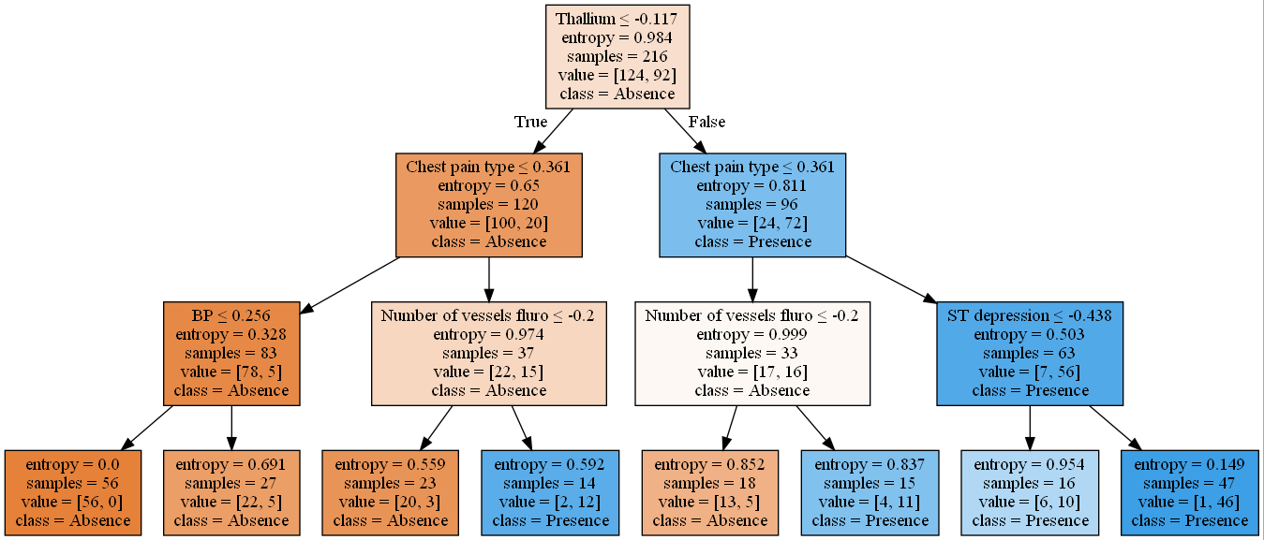
Performance analysis of SVM Model
DecisionTreeClassifier(criterion='entropy', max_depth=3)
DecisionTrees's training Accuracy: 0.8796
DecisionTrees's testing Accuracy: 0.7593
Average F1-score: 0.7580
Jaccard score: 0.5938

Slide 30
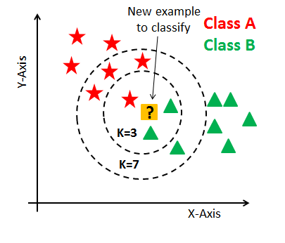
KNN or K Nearest Neighbor Classifier
K Nearest Neighbor is a simple algorithm that stores all the available cases and classifies the new data or case based on a similarity measure.
It is mostly used to classify a data point based on how its neighbors are classified.
It makes no assumptions about the data and is generally be used for classification tasks when there is very less or no prior knowledge about the data distribution.
This algorithm involves finding the k nearest data points in the training set to the data point for which a target value is unavailable and assigning the average value of the found data points to it.

Slide 31
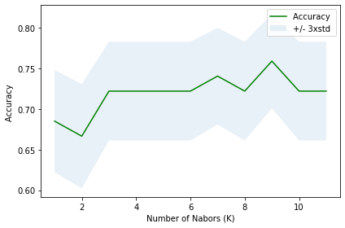
Performance analysis of KNN Model
Train set Accuracy: 0.8935
Test set Accuracy: 0.7593
Avg F1-score: 0.7563
Jaccard score: 0.5806
The best accuracy was with 0.7593 with k= 9

Slide 32
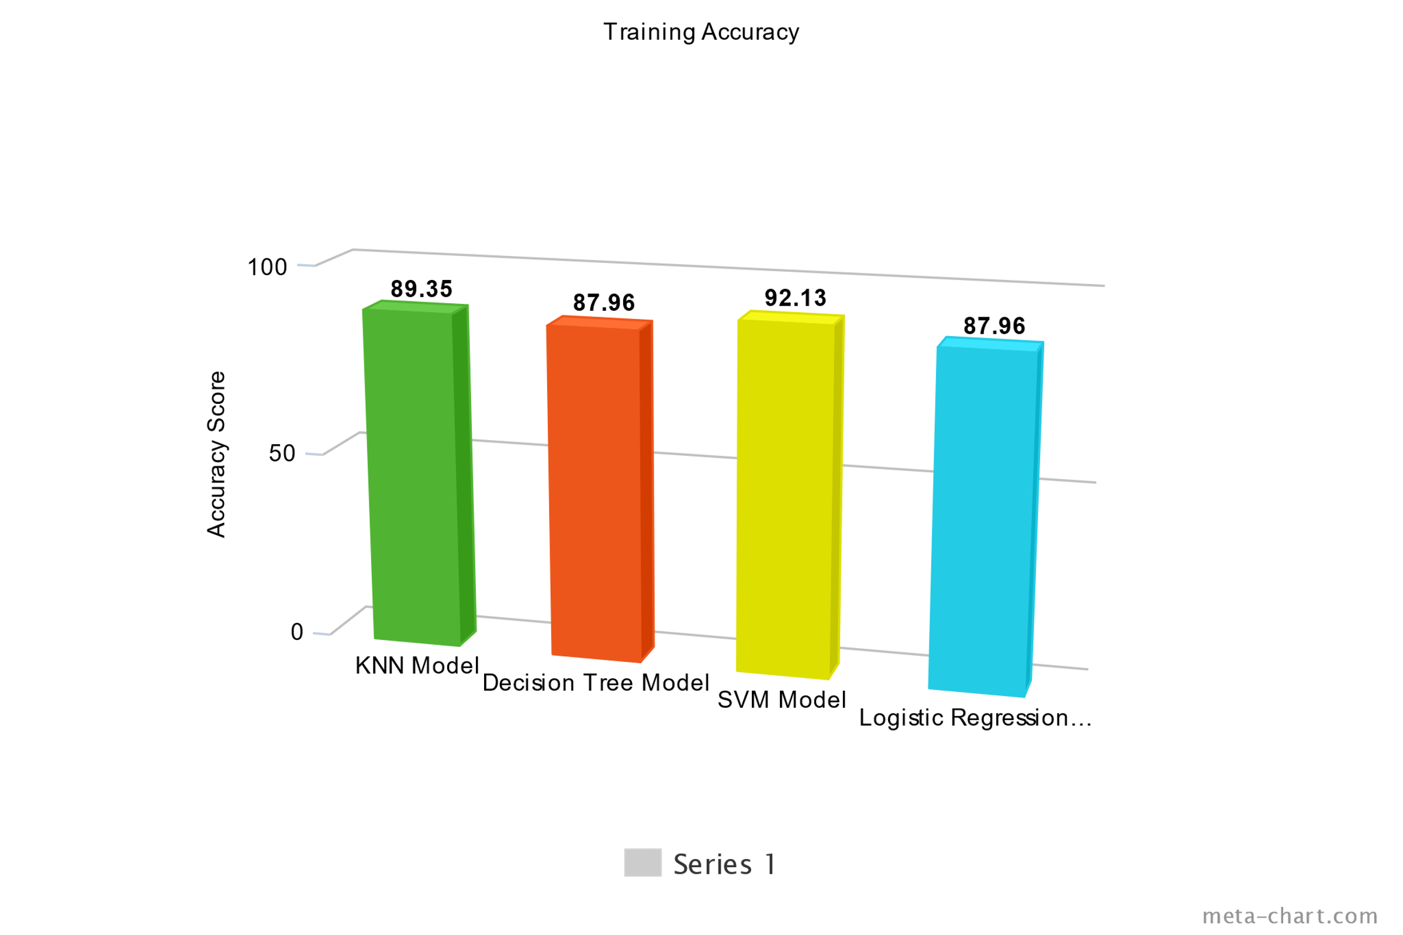
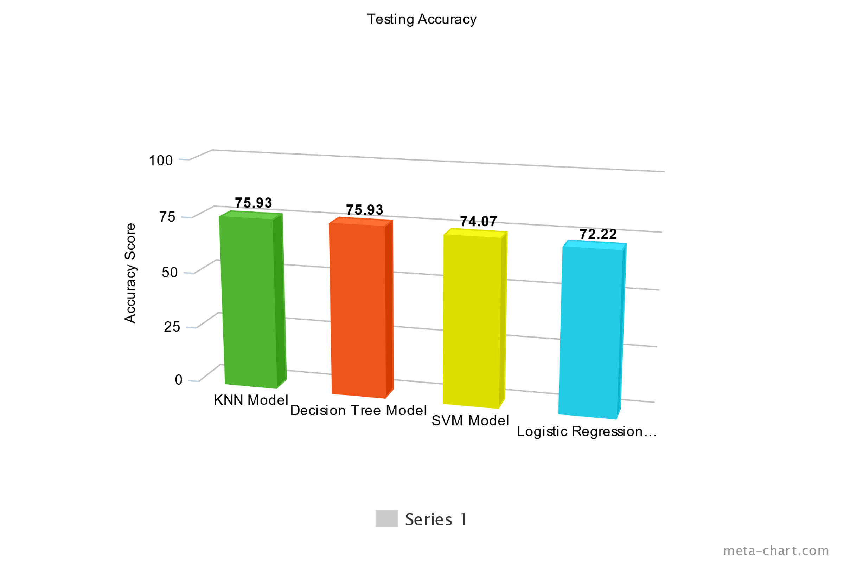
Comparison of Algorithms
Training Accuracy
Testing Accuracy

Slide 33
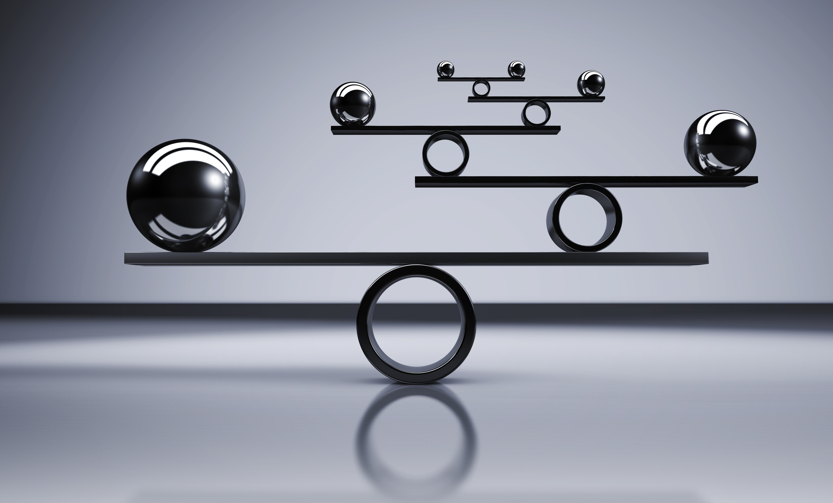
Thank You

